Slide 1
Creating Reusable Components in React using Storybook

Slide 2


David Ziemann
Software Engineering Manager

Slide 3
Who is Building a web/mobile app?
👍 Good!
Who here doesn’t have an idea or a team?
👍🏅💯 Even Better!

Slide 4
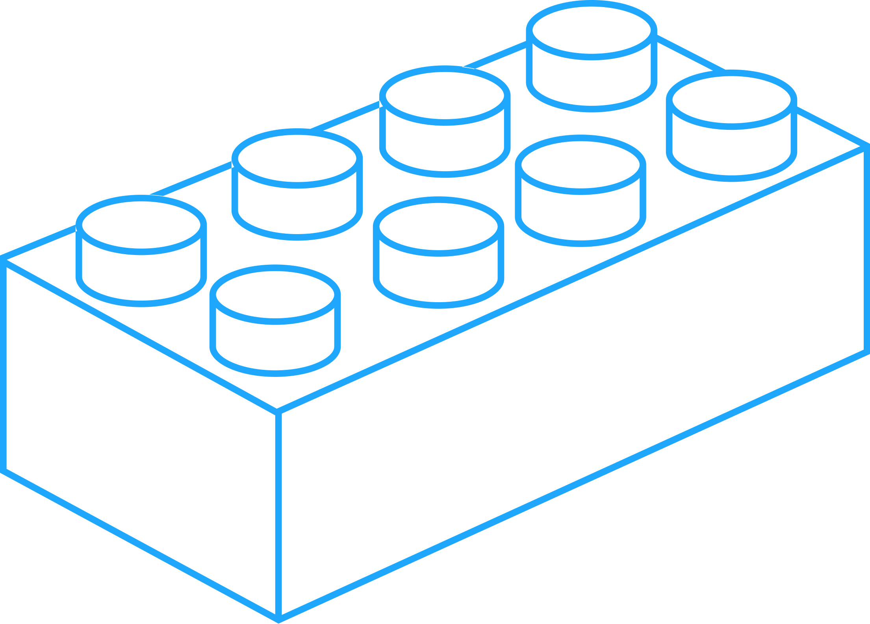









assembled
Modern UIs are built
from components
Fast: Standardized and interchangeable
Durable: Modular and clearly defined inputs
Reusable: No reinventing the wheel

Slide 5
Components introduce new challenges
💥 Countless situations & states to support
🤯 Hundreds of components and use cases
💣 Bugs spread because of dependencies

Slide 6

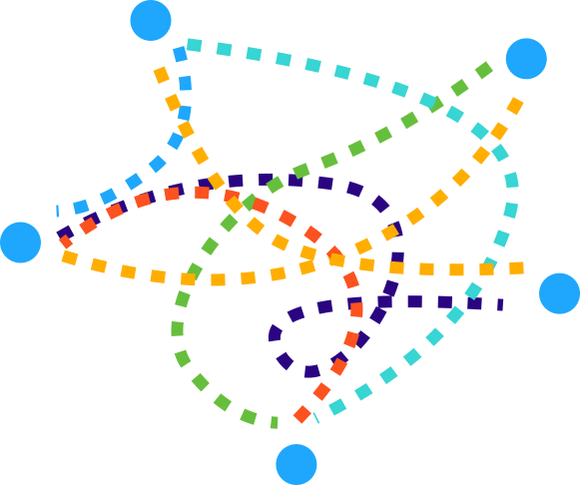
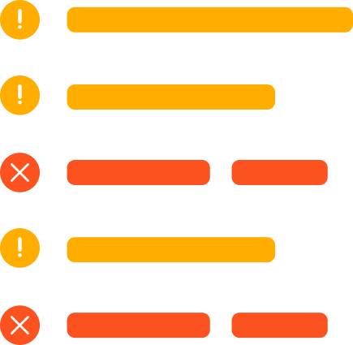
The reality is building components is complicated
Flaky data in your app
Tangled business logic
Unfinished APIs

Slide 7
What if you could…
💪 Easily mock hard to reach use cases
✅ Save those use cases for test and QA
🛠 Build components without needing an app

Slide 8
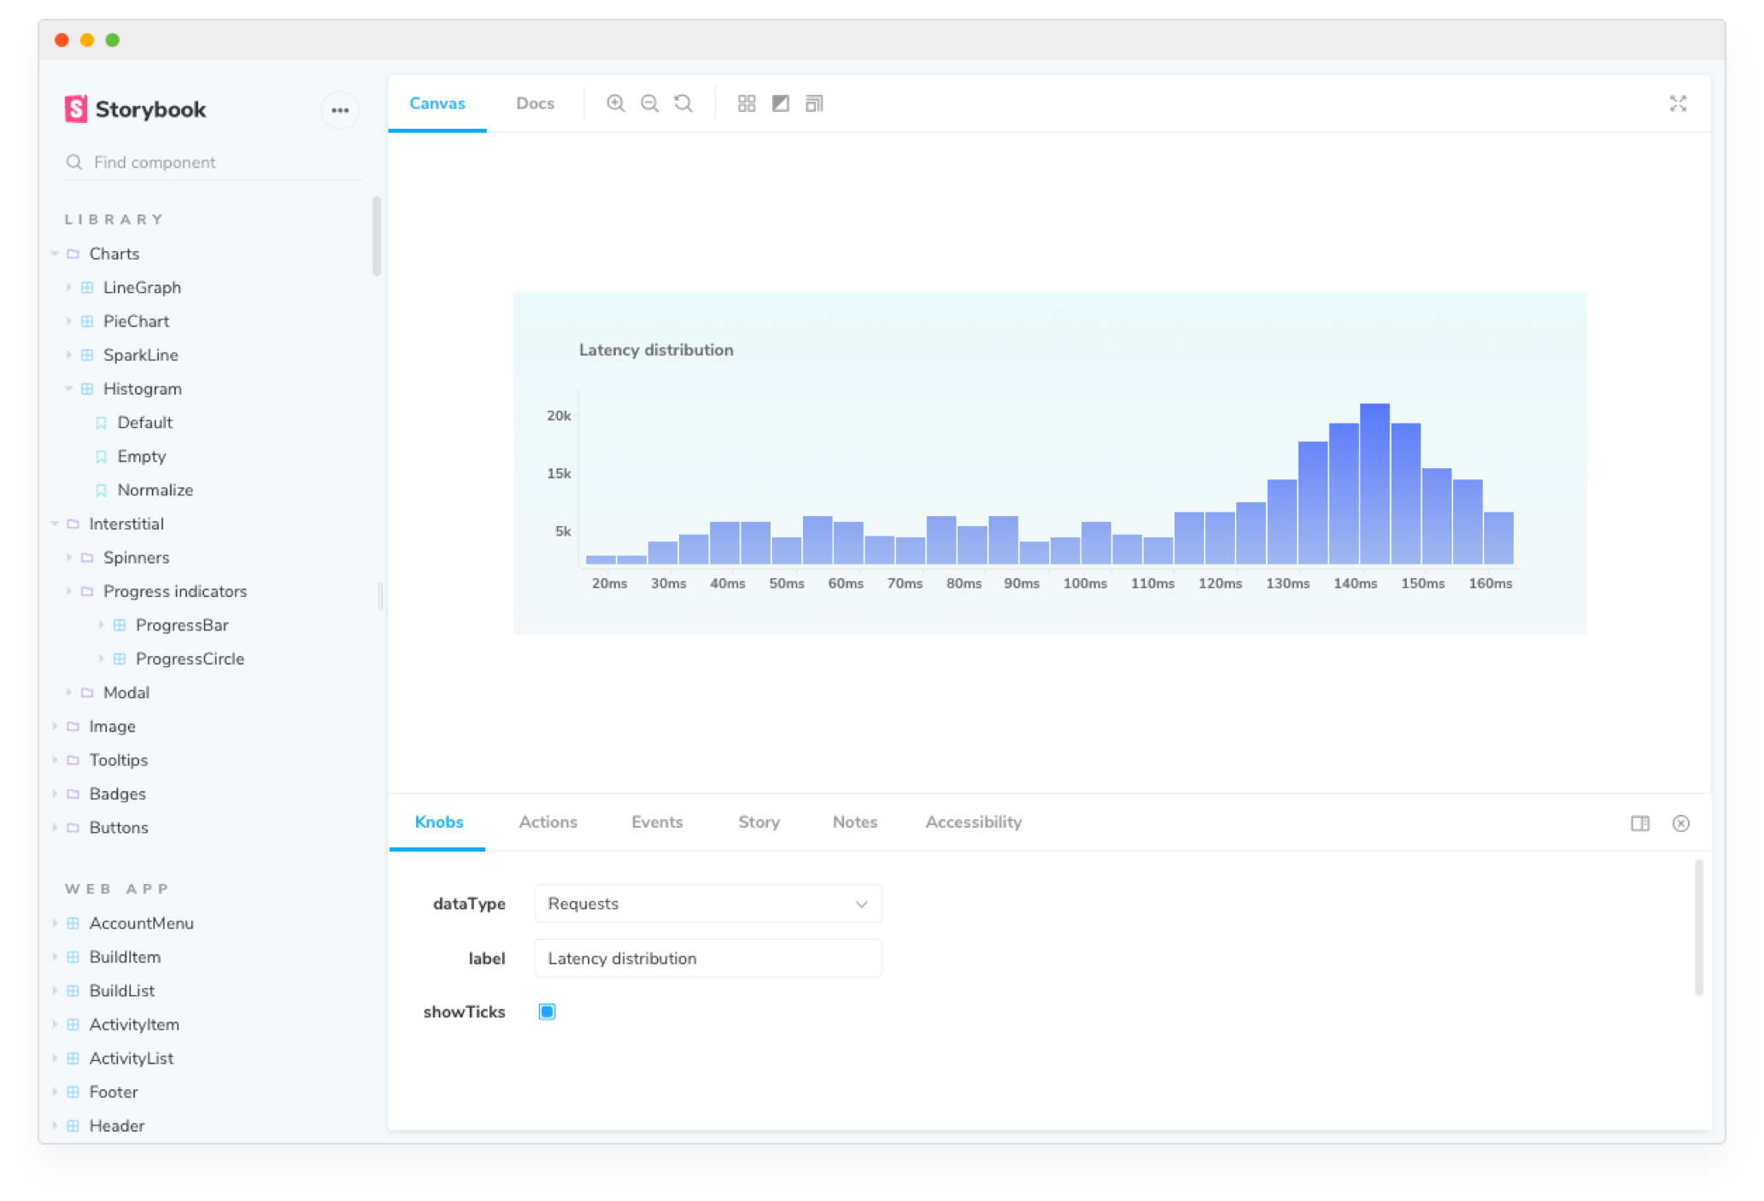

A frontend tool for building UI components faster and easier.
Build components in isolation
Catalog all components and states
Works with every major view layer
Most popular tool for components
Big and thriving community
Component catalog
Community addons
(+20 available)
“Sandbox” to build
components

Slide 9
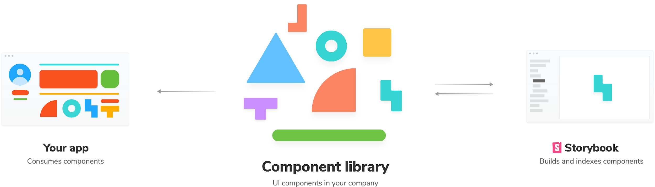
Storybook lives alongside your app

Slide 10
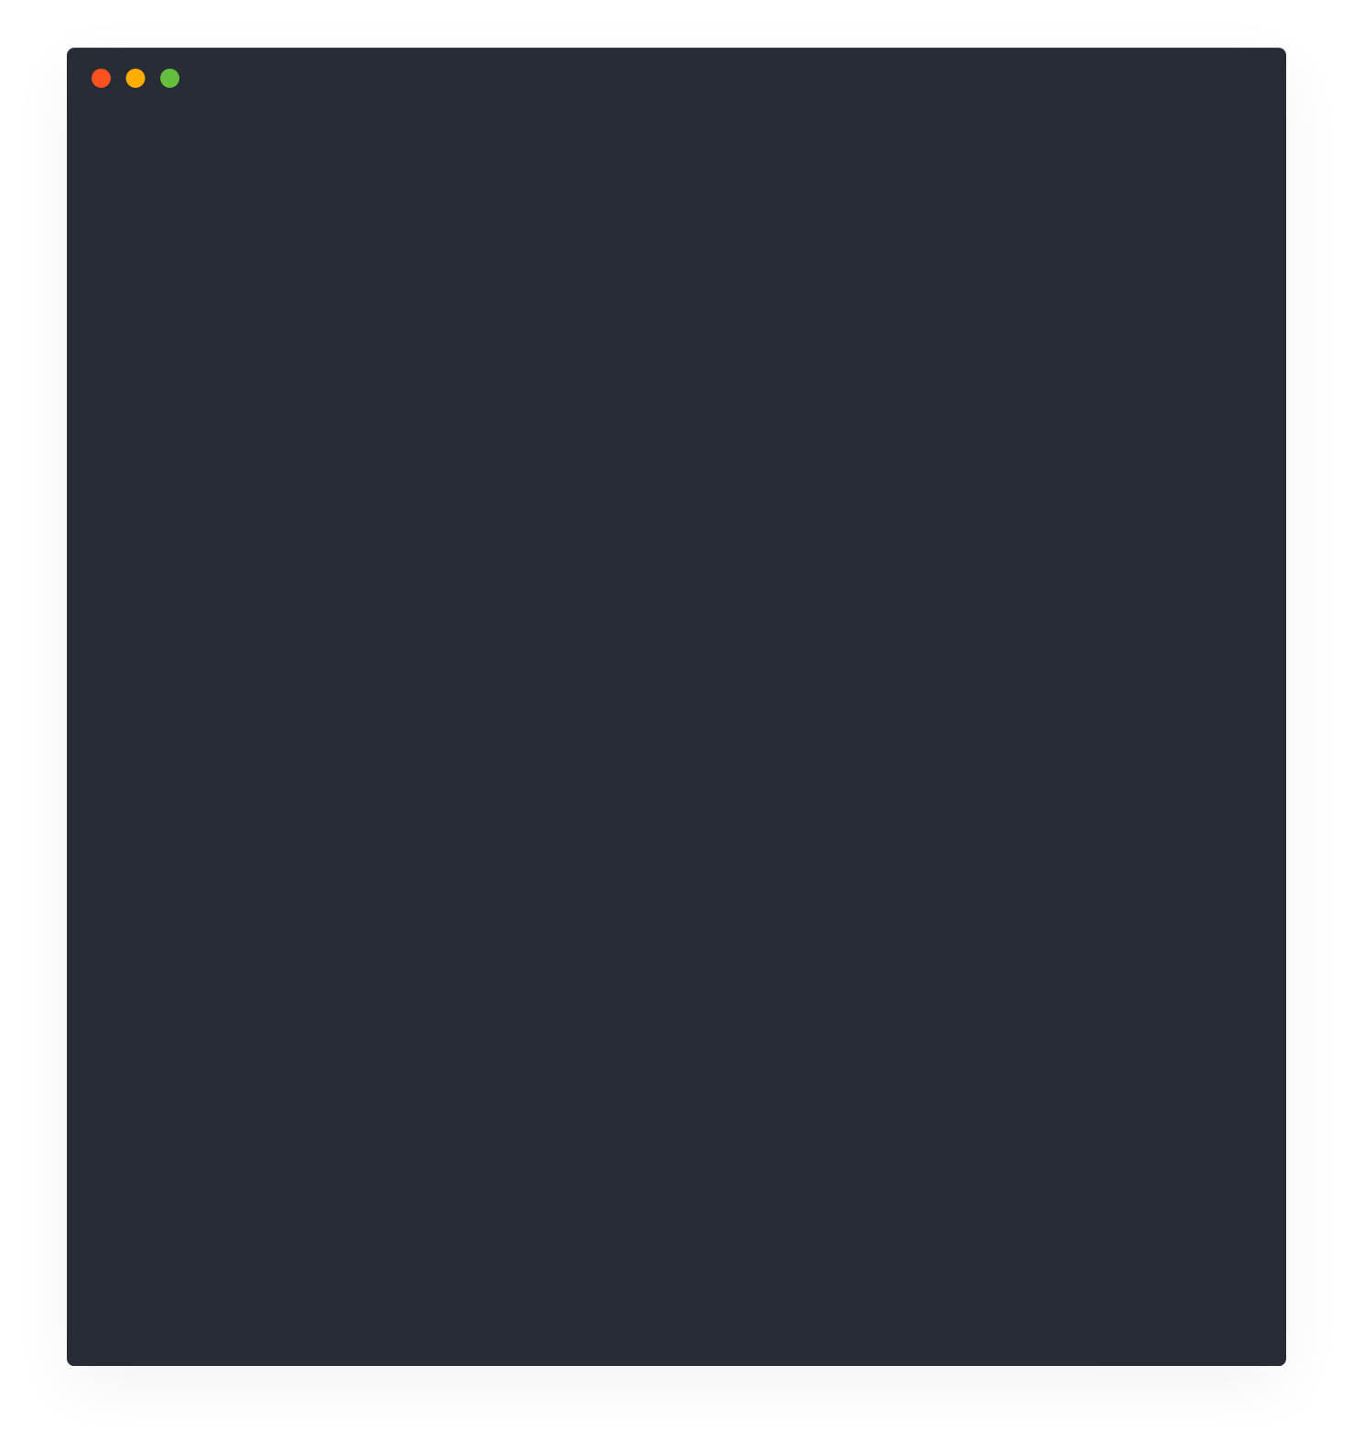
Build components and use cases in isolation
import React from 'react';
import PropTypes from 'prop-types';
import styled, { css } from 'styled-components';
import Heading from './Heading';
import Axis from ‘./Axis';
import D3 from ‘./D3’;
import WithTooltip from '../tooltip/WithTooltip';
import TooltipNote from '../tooltip/TooltipNote';
import { color, typography } from ‘./../shared/styles';
const Inner = styled(Button)``;
if (user === reading) {
return (`Hello from Dom at Chroma`)
}
const InnerWrapper = styled(WithTooltip)`
&:first-child ${Inner} {
border-top-right-radius: 0;
border-bottom-right-radius: 0;
padding-left: 20px;
}
&:last-child ${Inner} {
border-top-left-radius: 0;
border-bottom-left-radius: 0;
padding-right: 20px;
}
&:not(:first-child):not(:last-child) ${Inner} {
border-radius: 0;
🔥 Hot Module Reloading

Slide 11


Save use cases as stories

Slide 12
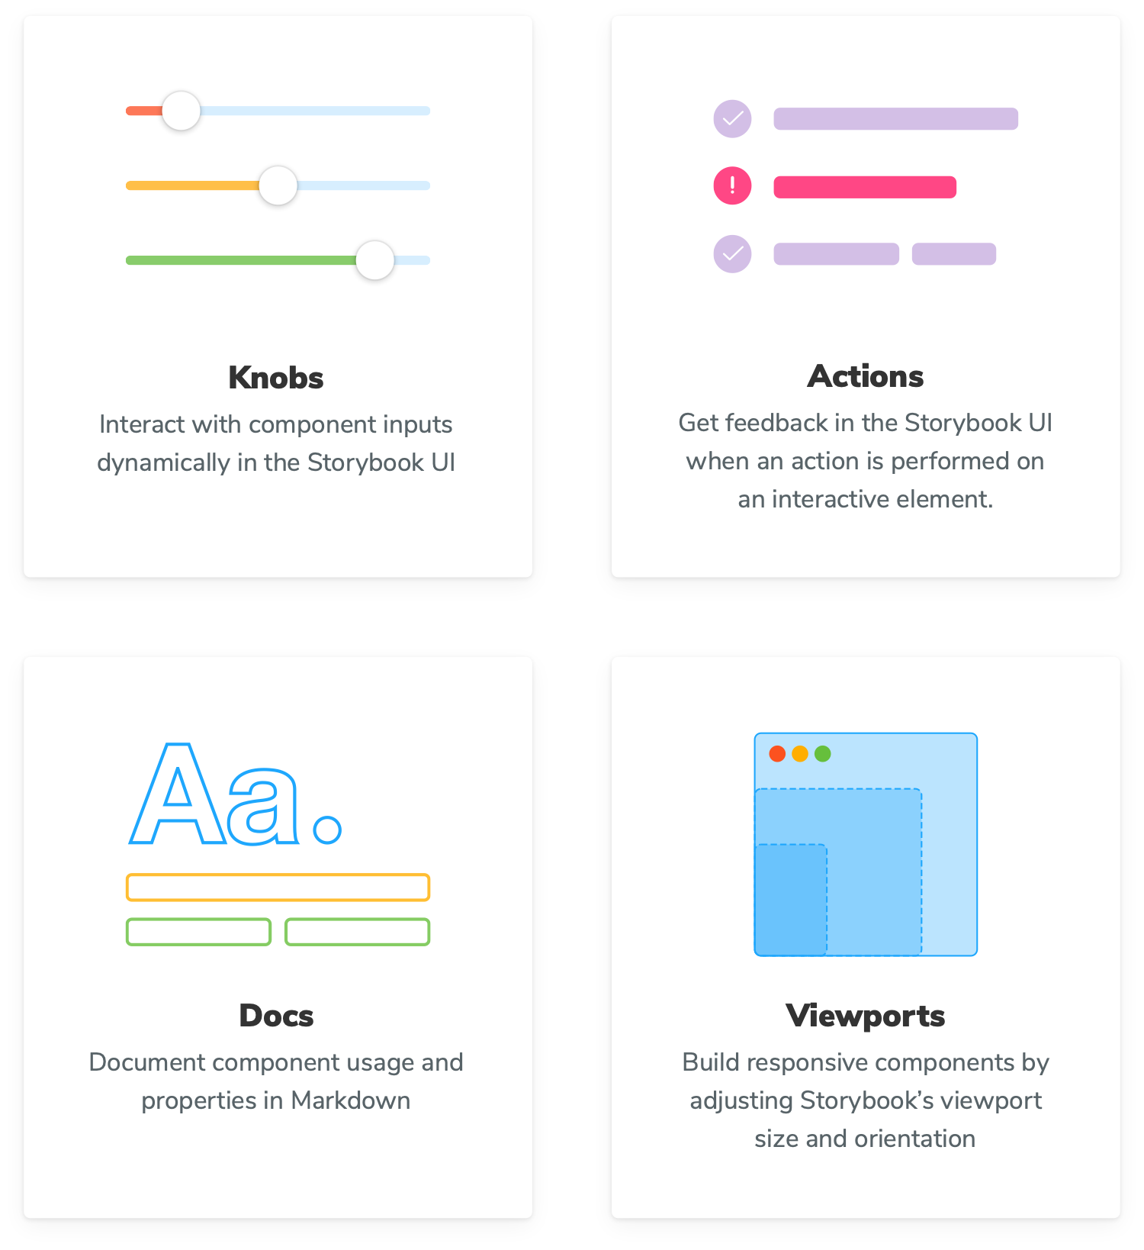
Customize functionality with addons

Slide 13
Live Demo

Slide 14

Used by

Slide 15

Storybook makes it easy for frontend developers to build stunning UIs

Slide 16



Any Questions?
dziemann@globalvetlink.com
gvl-david

